Slide 1
REDDIT ON RELATIONSHIPS

Slide 2
Why relationships?
Relationship issues are sensitive
May not have people to discuss with
Hesitancy to even seek advice anonymously
Searches for similar issues can be difficult
Multifaceted
Not able to describe issue concisely

Slide 3












Technologies & Workflow

Slide 4
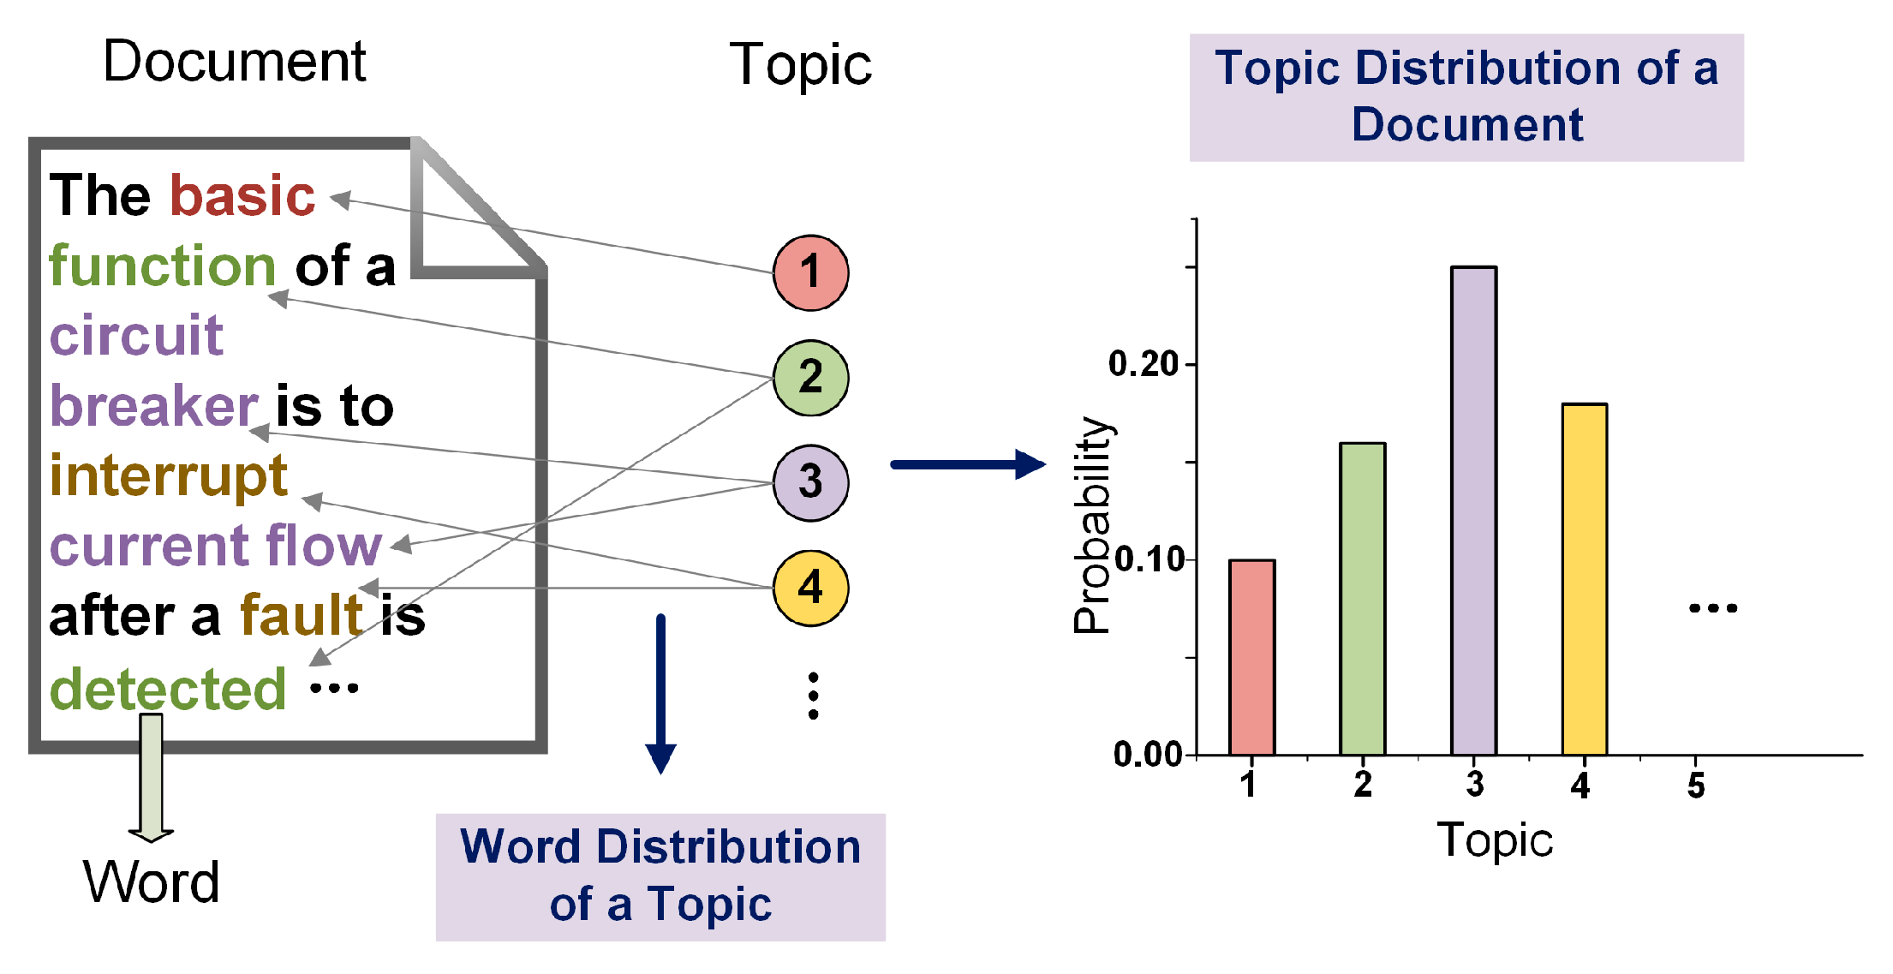
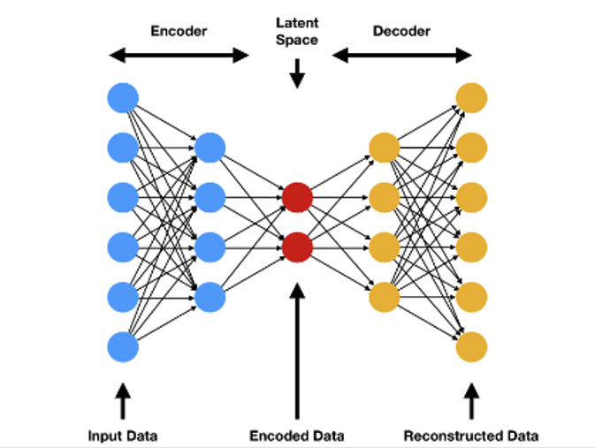
Contextual Topic Embeddings
LDA
Pr(topic|post)
Posts
All we do is fight…
Concatenate & Autoencoder
Encoded Posts
I’m tired of cleaning their mess…
Latent Space Representation
There are suspicious Snapchats…
BERT
Embeddings
Adapted from: https://github.com/Stveshawn/contextual_topic_identification

Slide 5
The communication in my relationship is terrible. We can never reach a resolution in a disagreement, and we're starting to argue more and more.

Slide 6
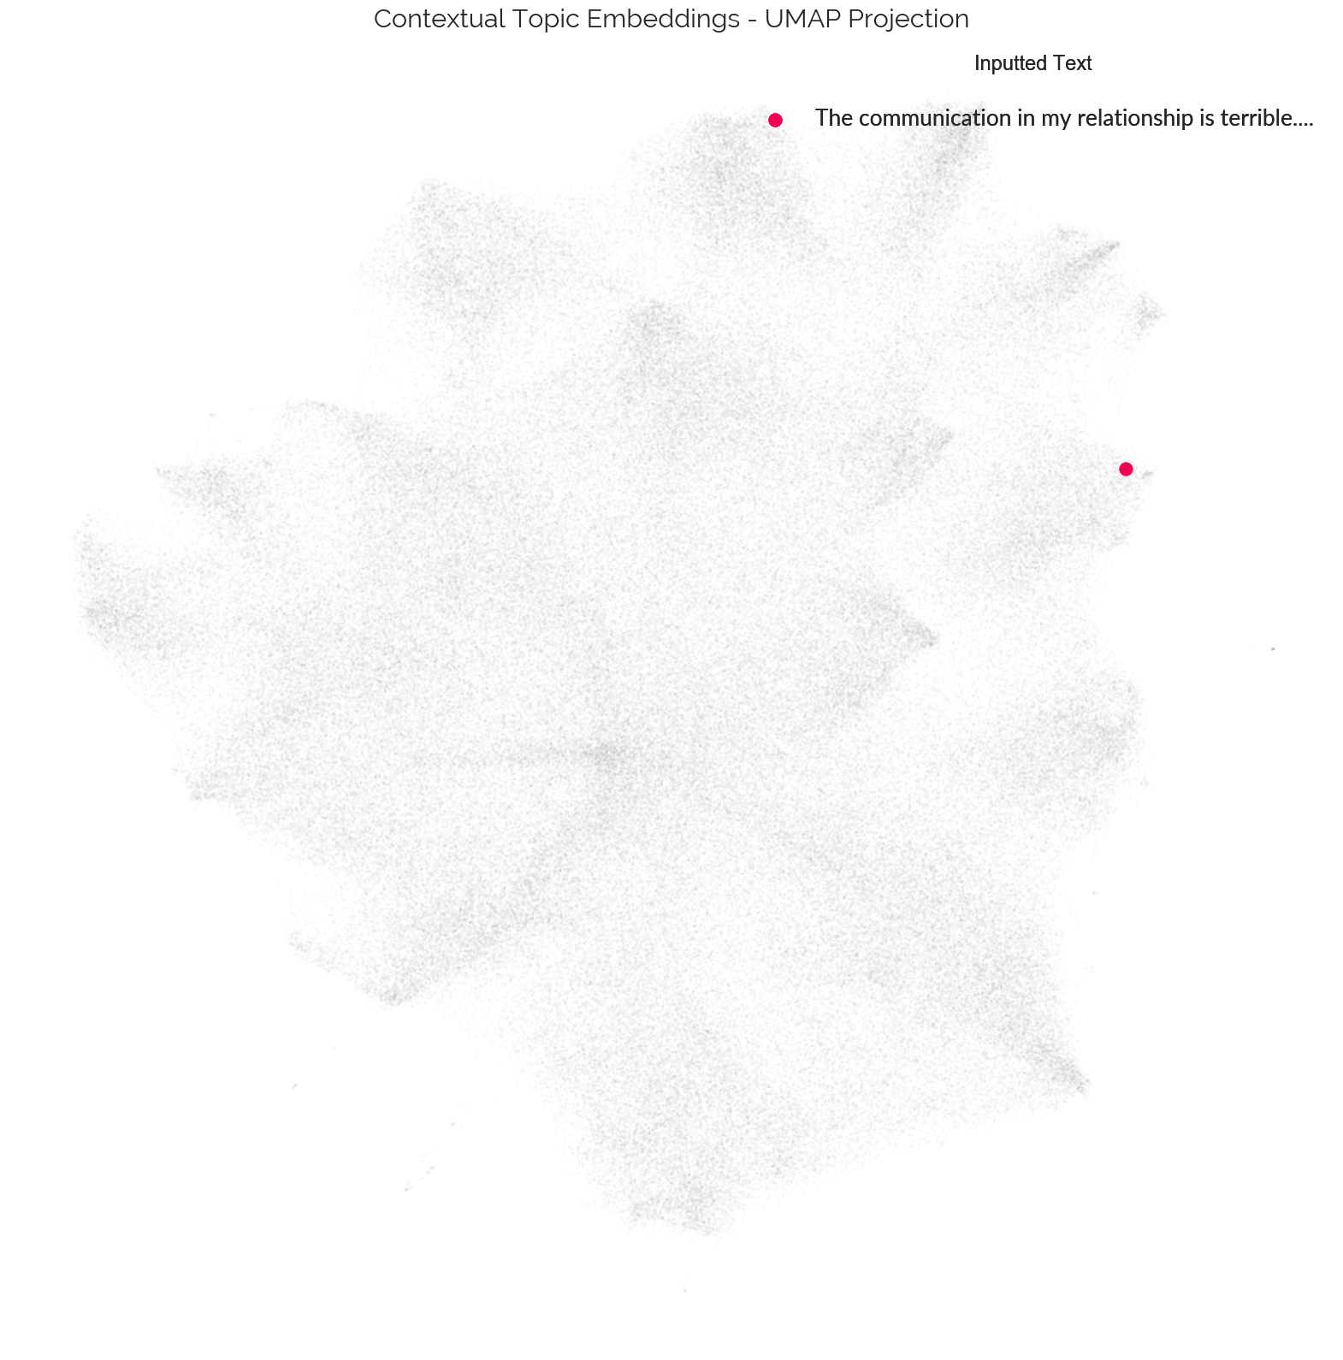
New text enters the post universe

Slide 7
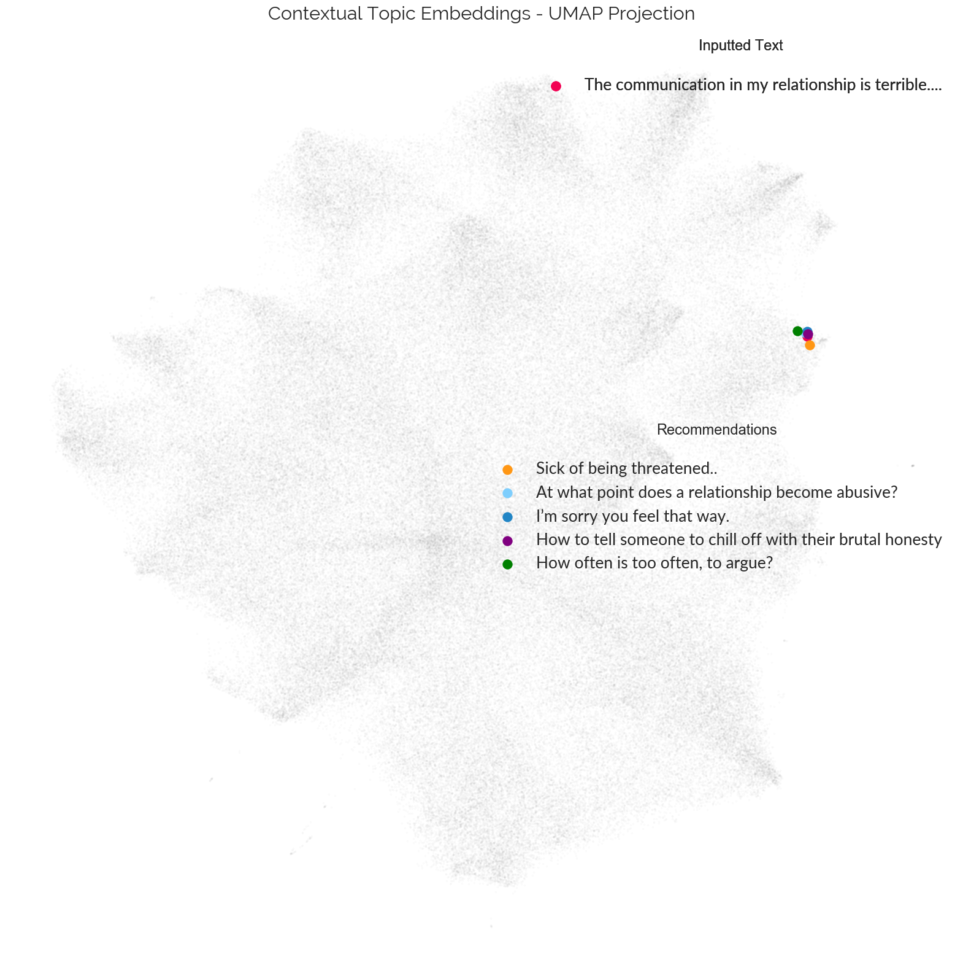
Recommendations based on distances

Slide 8
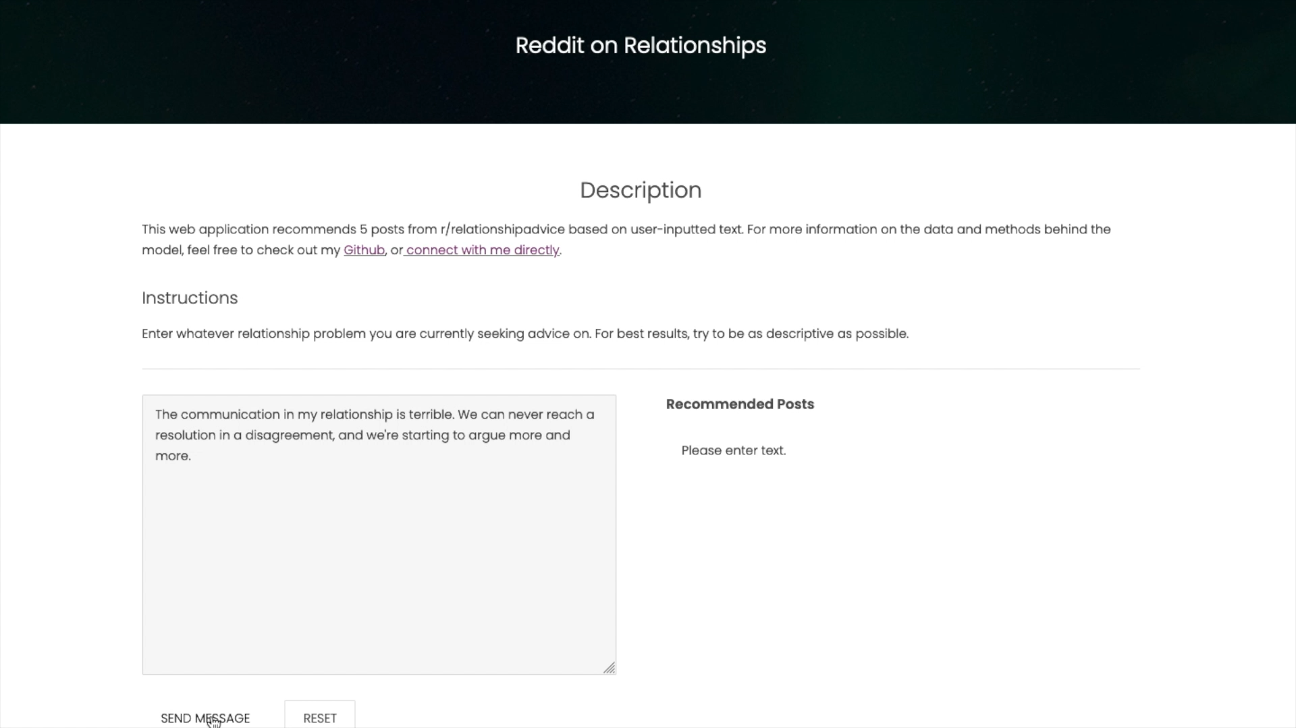
The user sees…

Slide 9
Limitations & Future Directions
Expand sample
Currently only based on relationships of Reddit users
Improve recommendations for traditional (i.e., shorter) searches
Tune hyperparameters ad infinitum
Adapt methodology to other domains (e.g., products sold on Amazon)

Slide 10
Thanks!
Email: bryan.ross.529@my.csun.edu
Github: https://github.com/rossbj92
Linkedin: https://www.linkedin.com/in/bryan-ross-07871452

Slide 11
Credits
Special thanks to all the people who made and released these awesome resources for free:
Presentation template by SlidesCarnival

